Slide 1
OOP with Python
Another intro.... again!

Slide 2
Intro
You've seen Python is useful for:
use as a calculator
ease of use to "try things out" in the interpreter
and that you can use it to:
write simple scripts
create functions
test functions on their own to test them
see how doctest can be used to test code
see how functions can be imported from one file to another
and use this to have test code be used to test functions (unit tests)

Slide 3
Next, we must look at
Dictionaries (just another data structure)
Recursion
Using more modules
Better program design
Better modularisation

Slide 4
Pre-requisites
Understand how to construct pseudo-code: this is the steps in "doing" something, broken down.
use of variables and structures (e.g. lists)
modularisation: breaking code into functions
use of conditionals (if, elif, else)
use of exception handling (try, except, finally)
using loops
look up docs (use help() for info on a module or function/method)

Slide 5
Dictionaries are fast
In computing, a hash table (hash map) is a data structure used to implement an associative array, a structure that can map keys to values.
A hash table uses a hash function to compute an index into an array of buckets or slots, from which the desired value can be found.

Slide 6
How?
Simple example (in reality a bit more complex, but this is the idea)
Take a dict of letters. 'a' maps to an ordinal value of 97 (in the interpreter, enter ord('a')
Now, in a list of lists, say that the 'key' is 'a' and at position in the list 97, the 'values' are stored in another list at index 97
Now you don't have to iterate through the list- one you get the ordinal value, you have the data at that position

Slide 7
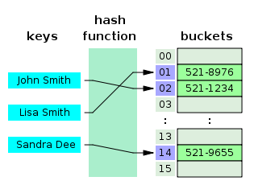
Applying the same idea:

Slide 8
In practise
Instead of having to "look through" the entire list in the phone book, the "key" can be generated quickly, and the phone number retrieved very quickly!
TWO important points!!
More than one entry per key not allowed. Which means no duplicate key is allowed.
Keys must be immutable. Which means you can use strings, numbers or tuples as dictionary keys
Values can be mutable, so values can include things like lists!

Slide 9
Commonly misunderstood
From StackOverflow:
I am only concerned about performance. I was coding a Euler problem, and wrote one version with a list and one with a dict.
Why does the second example using dictionaries run incredibly fast, faster than the first example with lists. the example with dictionaries runs almost thirty-fold faster! I tested these 2 code using n=1000000, and the first code run in 1032 seconds and the second one run in just 3.3 second,,, amazin'!

Slide 10
Dictionaries: syntax
Creating:
account1 = {'name': 'Jane Jones', 'Account': 1024587, 'type': 'Savings'}
Accessing:
print "account1['name']: ", account1['name']
print "account1['type']: ", account1['type']
If the value is not there, we have to avoid an error

Slide 11
Dictionary: mod or add more
You can update a dictionary by adding a new entry or a key-value pair, modifying an existing entry, or deleting an existing entry.
account1['type'] = "Current"
account1['name'] = "Jane Smith"
account1['branch'] = "Athlone"
account1['credit'] = 1013.54

Slide 12
Dictionary: mod or add more
You can delete a part of the dictionary
del account1['branch']
Or you can empty the entire thing:
account1.clear()
Look up the methods that are available for the python dictionary and take a note of at least three that you think may be useful!

Slide 13
Exercise 1: OOP View
Create a class diagram for a bank account that must store the following data:
name
account type
account type
balance
bank branch
and have the appropriate methods for each
ALL of them!
Part of both OOP and SW Arch

Slide 14
Exercise 1: functional implementation
Create a program to use a dictionary to hold all the bank details of a customer
what is the unique key that should be used for each?
this empty dict can be initialised at the beginning of the program with default values
It must accept user input for all the details:
It does not have to be a "class" (yet) or have all the methods identified in the class diagram (yet)
Make sure that you use functions for each part of the program!
Notes:
Part of both OOP and SW Arch

Slide 15
Use Case
In software and systems engineering, a use case is a list of actions or event steps, typically defining the interactions between a role (known in the Unified Modeling Language as an actor) and a system, to achieve a goal.
The actor can be a human or other external system.
Part of both OOP and SW Arch

Slide 16
Use case: bank account
What are the use cases that are missing from our implementation of a bank account?
Look at:
www.bridging-the-gap.com/what-is-a-use-case/
and to write even better use cases:
www.gatherspace.com/static/use_case_example.html

Slide 17
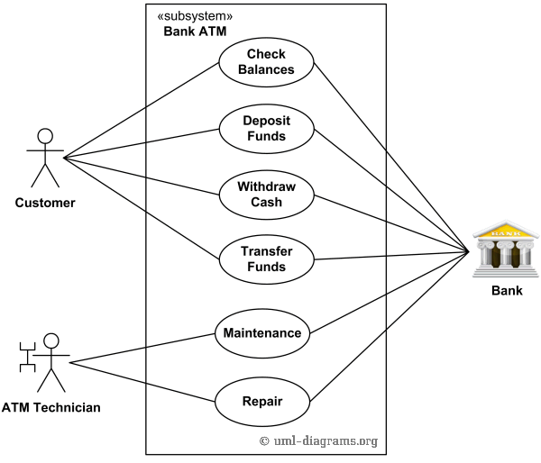
Use case diagram for an ATM

Slide 18
Use case for a bank account
Create the use case diagram for a bank account
Update the class diagram for the bank account class

Slide 19
Creating a "BankAccount" class
Base on your analysis of the "Person" class, write the code for a bank account class.

Slide 20
What is an Object?
A software item that contains variables and methods
Object Oriented Design focuses on
Encapsulation:
dividing the code into a public interface, and a private implementation of that interface
Polymorphism:
the ability to overload standard operators so that they have appropriate behavior based on their context
Inheritance:
the ability to create subclasses that contain specializations of their parents
str
int
float
bool
list
dict

Slide 21
Namespaces (like __main__ )
At the simplest level, classes are simply namespaces
class myfunctions:
def exp():
return 0
>>> math.exp(1)
2.71828...
>>> myfunctions.exp(1)
0
It can sometimes be useful to put groups of functions in their own namespace to differentiate these functions from other similarly named ones.

Slide 22
Python Classes
Python contains classes that define objects
Objects are instances of classes
class Atom:
def __init__(self,atno,x,y,z):
self.atno = atno
self.position = (x,y,z)
self refers to the object itself

Slide 23
Atom Class
class atom:
def __init__(self,atno,x,y,z):
self.atno = atno
self.position = (x,y,z)
def symbol(self): # a class method
return Atno_to_Symbol[atno]
def __repr__(self): # overloads printing
return '%d %10.4f %10.4f %10.4f' %
(self.atno, self.position[0],
self.position[1],self.position[2])
>>> at = atom(6,0.0,1.0,2.0)
>>> print at
6 0.0000 1.0000 2.0000
>>> at.symbol()
'C'

Slide 24
The Atom class
Overloaded the default constructor
Defined class variables (atno,position) that are persistent and local to the atom object
Good way to manage shared memory:
instead of passing long lists of arguments, encapsulate some of this data into an object, and pass the object.
much cleaner programs result
Overloaded the print operator
We now want to use the atom class to build molecules...

